Slide 1

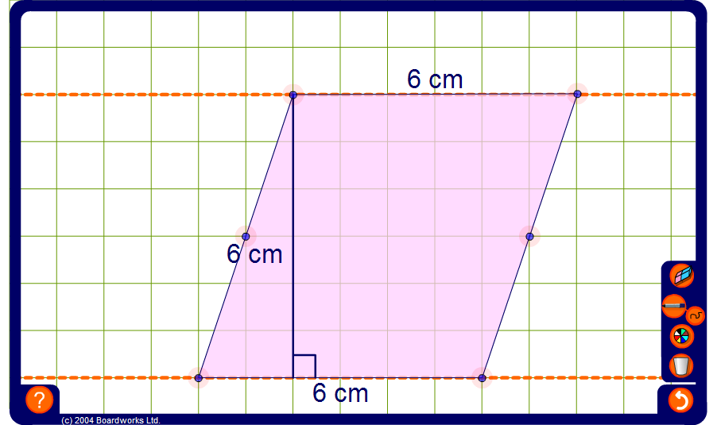


Area of a parallelogram
Notes:
Ask pupils to suggest ways to find the area of the parallelogram. This can be done by imagining a right-angled triangle cut off from one end and moved to the other. Use the pen tool set to draw straight lines to show this if required.
Drag the vertices of the parallelogram to make a rectangle. Confirm that the area of the original parallelogram and the area of the rectangle are the same.
Modify the parallelogram while keeping the length of the base and the height constant. Conclude that if the length of the base and the height of the parallelogram are kept constant then the area will remain the same regardless of the slope.
By looking at further examples deduce that the area of any parallelogram can be found by multiplying the length of the base by the perpendicular height.
Discuss the fact that we do not need to know the diagonal length on the parallelogram; warn pupils not to fall into the trap of using this measure rather than the perpendicular height.

